Slide 1
Israel and the Middle East

Slide 2

Growing Jewish Population of Israel
1897 Herzl declares support for Jewish Homeland in Israel: 20,000 to 50,000 Jews, vs. 500,000 Arabs.

Slide 3
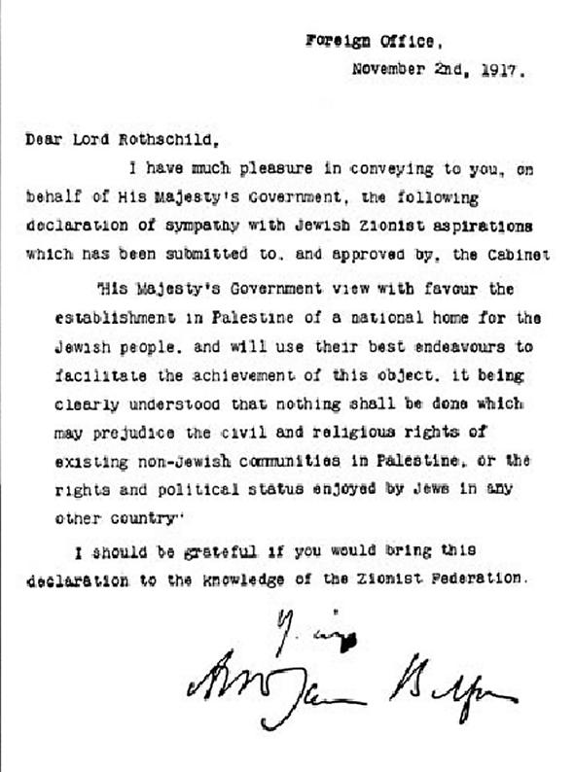
Balfour Declaration
In 1917, in an attempt to win the support of American Jews for the entry of the US into WWI, Britain pledges their support to the creation of a Jewish homeland. Jews are about 10 % of population, compared to 90% Arabs.

Slide 4
Period of British Rule
1922, Palestine was made mandate of Britain- but they dragged their feet about establishing a Jewish homeland. The period of British rule sees growing Arab protests against establishing Israel.
1930s: Rise of Hitler rapidly accelerates movement of Jews into Israel.
1939 Britain repudiates Balfour Declaration, limits Jewish immigration into Israel, just as European death camps are being established.

Slide 5
Important Wars
1948 Arab-Israeli War
1956 Suez Crisis
1967 War (Six Days War)
1973 Yom Kippur War

Slide 6
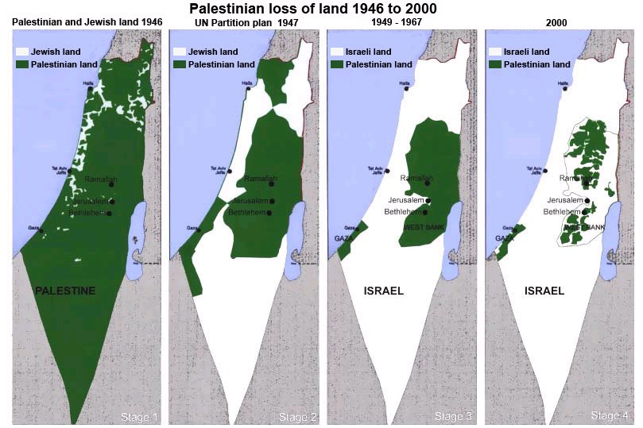
Loss of Palestinian land to the State of Israel

Slide 7
Option 1: Status Quo
If Israel continues under the current situation, the growth of the Palestinian population means that Israel will not be able to remain both a democratic government and a Jewish nation. It will need to choose one or another.

Slide 8
Option 2: Expulsion of Palestinians
If Israel expanded the settlements in the West Bank, and expelled the Palestinians, it would have a large, primarily Jewish state. The ethnic cleansing of the Palestinians would be one of the great humanitarian crimes of our time, however.

Slide 9
Option 3: Creation of Palestinian State in West Bank
Pro: Would recognize national aspirations of both Palestinians and Israelis. Possibly it could defuse Palestinian anger and lead to more moderation. Israel could remain true to democratic ideals
Con: If Palestinians remained radicalized, new state could be a threat to Israeli security and a base for terrorist attacks. What do you do with the settlements?

Slide 10
Regimes
Algeria: Authoritarian secular regime
Egypt: Military rule (elections?)
Iraq: Unstable democracy
Jordan: Constitutional monarchy
Kuwait: Constitutional monarchy
Lebanon: Semi-democracy
Libya: Provisional government

Slide 11
Regimes (cont’d)
Morocco: Constitutional monarchy
Saudi Arabia: Monarchy
Syria: Harsh authoritarian; civil war
Tunisia: New democracy
Yemen: Unfree Republic.

Slide 12

Syria
President Bashar Assad is the dictator and son of previous dictator, Hafez Assad.
Population of 22 million.
Ruled by the minority Alawite sect of Islam (considered heretical by both Sunnis and Shi’ites)

Slide 13
The Revolt Against Assad
Revolt began in 2011, protests were met by deadly force and population turned to armed resistance.
Key group is the FSA: Free Syrian Army (about 100,000 fighters).
Deaths from the conflict number over 90,000, with as many as 3 million displaced (some internally)

Slide 14
Religious Dimension
Rebels tend to be Sunni Muslims (and enjoy the support of other Sunni states in the region such as Saudi Arabia).
The government is secular, but dominated by Alawites, a heretical offshoot of Shi’ite Islam. They are supported by the other major Shi’ite country in the region, Iran.

